Slide 1
Software Engineering & Testing
Briefing of complete Syllabus:
Unit 02: Designing of Software
Designing process, Design Quality , Design model,
Architectural design, UI, UML : methods, types,
developing diagrams & Use cases.

Slide 2
Software Engineering & Testing
Unit 02: Designing of Software
- Software design is a mechanism to transform user requirements into some suitable form, which helps the programmer in software coding and implementation.
The software design phase is the first step in SDLC , which moves the concentration from the problem domain to the solution domain.
In software design, we consider the system to be a set of components or modules with clearly defined behaviour & boundaries.

Slide 3
Software Engineering & Testing
Unit 02: Designing of Software
-The design phase of software development deals with transforming the customer requirements as described in the SRS documents into a form implementable using a programming language.
Design creates a representation or model of the software.
Design model provides details about S/W architecture, interfaces and components that are necessary to implement the system.
Quality is established during Design. Design should exhibit firmness, commodity and design.

Slide 4
Software Engineering & Testing
Unit 02: Designing of Software
-Design sits at the kernel of S/W Engineering. Design sets the stage for construction.
The software design phase is the first step in SDLC (Software Design Life Cycle), which moves the concentration from the problem domain to the solution domain.

Slide 5
Software Engineering & Testing
Unit 02: Designing of Software
-Objectives of Software Design
1) Correctness : Software design should be correct as per requirement.
2) Completeness : The design should have all components like data structures, modules, and external interfaces, etc.
3) Efficiency : Resources should be used efficiently by the program.
4) Flexibility : Able to modify on changing needs.
5) Consistency : There should not be any inconsistency in the design.
6) Maintainability : The design should be so simple so that it can be easily maintainable by other designers.

Slide 6
Software Engineering & Testing
Unit 02: Designing of Software
- QUALITY GUIDELINES
• Uses recognizable architectural styles or patterns
• Modular; that is logically partitioned into elements or
subsystems
• Distinct representation of data, architecture, interfaces
and components
• Appropriate data structures for the classes to be implemented
• Independent functional characteristics for components
• Interfaces that reduces complexity of connection
• Repeatable method

Slide 7
Software Engineering & Testing
Unit 02: Designing of Software
QUALITY ATTRIBUTES
•The attributes of design name as ' PSURF ‘ are as follows:
Performance: It is measured by considering processing speed, response time, resource consumption, throughput and efficiency.
Supportability:
It combines the ability to extend the program, adaptability, serviceability. These three term defines the maintainability.
Usability: It is accessed by considering the factors such as human factor, overall aesthetics, consistency and documentation.

Slide 8
Software Engineering & Testing
Unit 02: Designing of Software
QUALITY ATTRIBUTES
•The attributes of design name as ' PSURF ‘ are as follows: Performance: It is measured by considering processing speed, response time, resource consumption, throughput and efficiency.
Supportability:
It combines the ability to extend the program, adaptability, serviceability. These three term defines the maintainability.
Usability: It is accessed by considering the factors such as human factor, overall aesthetics, consistency and documentation.
Reliability: It is evaluated by measuring parameters like frequency and security of failure, output result accuracy, the mean-time-to-failure(MTTF), recovery from failure and the program predictability.
Functionality: It evaluates the feature set and capabilities of the program.

Slide 9
Software Engineering & Testing
Unit 02: Designing of Software
-DESIGN CONCEPTS
Abstractions
Architecture
Patterns
Modularity
Information Hiding
Functional Independence
Refinement
Re-factoring
Design Classes

Slide 10
Software Engineering & Testing
Unit 02: Designing of Software
-DESIGN CONCEPTS
Concepts are defined as a principal idea or invention that comes into our mind or in thought to understand something.
Idea or principle behind the design.
There are many concepts of software design and some of them are given below:

Slide 11
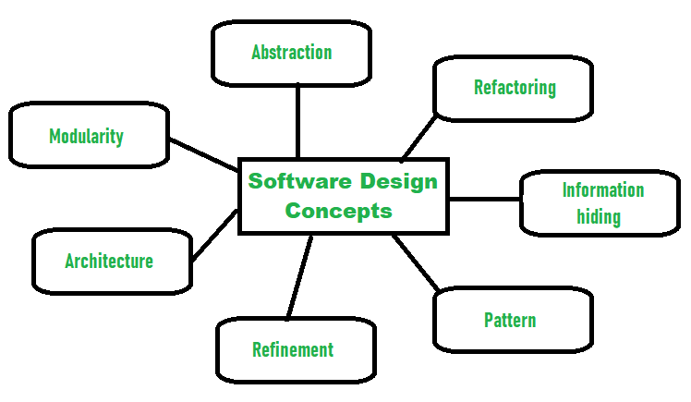
Software Engineering & Testing
Unit 02: Designing of Software
DESIGN CONCEPTS

Slide 12
Software Engineering & Testing
Unit 02: Designing of Software
DESIGN CONCEPTS
1) Abstraction:
Is the process of hiding complex properties or characteristics from the software itself to keep things more simplistic.
The developers will be able to hide the complicated and unnecessary details in the background while retaining core information in the foreground.
Abstraction simply means to hide the details to reduce complexity and increases efficiency or quality.

Slide 13
Software Engineering & Testing
Unit 02: Designing of Software
DESIGN CONCEPTS
2) Modularity
Modularity simply means dividing the system or project into smaller parts to reduce the complexity of the system or project.
Means subdividing a system into smaller parts and use them independently in different systems to perform different functions.
Modularity make the system easy to manage.

Slide 14
Software Engineering & Testing
Unit 02: Designing of Software
DESIGN CONCEPTS
3) Architecture- Design a structure of something,
Architecture simply means a technique to design a structure of something.
Structure organization of program components (modules) and their interconnection Architecture Models are,
(a) Structural Models-- An organized collection of program components
(b) Framework Models-- Represents the design in more abstract way
(c) Dynamic Models-- Represents the behavioural aspects indicating changes as a function of external events .
(d) Process Models-- Focus on the design of the business or technical process.

Slide 15
Software Engineering & Testing
Unit 02: Designing of Software
DESIGN CONCEPTS
4) Refinement- removes impurities Refinement simply means to refine something to remove any impurities if present and increase the quality.
Refinement is very necessary to find out any error if present and then to reduce it.

Slide 16
Software Engineering & Testing
Unit 02: Designing of Software
DESIGN CONCEPTS
5) Pattern- a repeated form
The pattern in the design process means the repetition of a solution to a common recurring problem within a certain context.
Provides a description to enables a designer to determine the followings:
(a) whether the pattern is applicable to the current work
(b)Whether the pattern can be reused
(c) Whether the pattern can serve as a guide for developing a similar
but functionally or structurally different pattern .

Slide 17
Software Engineering & Testing
Unit 02: Designing of Software
DESIGN CONCEPTS
6) Information Hiding- hide the information
Information hiding simply means to hide the information so that it cannot be accessed by an unwanted party.
- Hiding in such a way that the information gathered or contained in one module is hidden and can’t be accessed by any other modules.

Slide 18
Software Engineering & Testing
Unit 02: Designing of Software
DESIGN CONCEPTS
7) Refactoring- reconstruct something
Defined refactoring as “the process of changing a software system in a way that it won’t affect the behaviour of the design and improves the internal structure”.
-Refactoring simply means reconstructing something in such a way that it does not affect the behaviour of any other feature.

Slide 19
Software Engineering & Testing
Unit 02: Designing of Software
DESIGN CONCEPTS
8) Information Hiding- hide the information
Information hiding simply means to hide the information so that it cannot be accessed by an unwanted party.
- Hiding in such a way that the information gathered or contained in one module is hidden and can’t be accessed by any other modules.

Slide 20
Software Engineering & Testing
Unit 02: Designing of Software
-The software design process can be divided into the following three levels of phases of design:
1) Interface Design
2) Architectural Design
3) Detailed Design

Slide 21
Software Engineering & Testing
Unit 02: Designing of Software
1) Architectural Design -
The architectural design is the highest abstract version of the system. It identifies the software as a system with many components interacting with each other.
The architecture of a system can be viewed as the overall structure of the system.
At this level, the designers get the idea of the proposed solution domain.

Slide 22
Software Engineering & Testing
Unit 02: Designing of Software
2) High-level design:
- Here the problem is decomposed into a set of modules, the control relationship among various modules identified, and also the interfaces among various modules are identified.
-Design representation techniques used in this stage are structure chart and UML.
- It recognizes modular structure of each sub-system and their relation and interaction among each other.

Slide 23
Software Engineering & Testing
Unit 02: Designing of Software
3) Detailed design: -In detailed design, each module is examined carefully to design the data structure and algorithms.
The stage outcome is documented in the form of a module specification document.
It is more detailed towards modules and their implementations.

Slide 24
Software Engineering & Testing
Unit 02: Designing of Software
DESIGN CLASSES
Class represents a different layer of design architecture. Five types of Design Classes
1. User interface class -- Defines all abstractions that are necessary for human computer interaction
2. Business domain class -- Refinement of the analysis classes that identity attributes and services to implement some of business domain
3. Process class -- implements lower level business abstractions required to fully manage the business domain classes

Slide 25
Software Engineering & Testing
Unit 02: Designing of Software
DESIGN CLASSES
4. Persistent class -- Represent data stores that will persist beyond the execution of the software
5. System class -- Implements management and control functions to operate and communicate within the computer environment and with the outside world

Slide 26
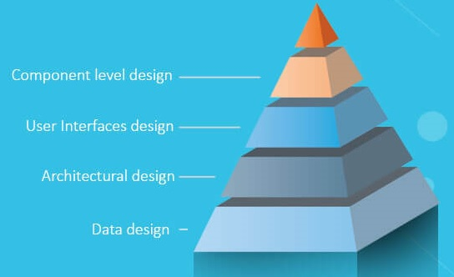
Software Engineering & Testing
Unit 02: Designing of Software
Design modelling :

Slide 27
Software Engineering & Testing
Unit 02: Designing of Software
Design modelling :
1) Design modelling in software engineering represents the features of the software that helps engineer to develop it effectively, 2) Design modeling is useful in dealing with the architecture, the user interface, and the component level detail.
3) Design modeling provides a variety of different views of the system like architecture plan for home or building.

Slide 28
Software Engineering & Testing
Unit 02: Designing of Software
Design modelling :
In this we have a multi-process that represent the data structure, program structure, interface characteristic, and procedural details. It is mainly classified into four categories –
1) Data design
2) Architectural design
3) Interface design
4) Component-level design
5) Deployment level design elements

Slide 29
Software Engineering & Testing
Unit 02: Designing of Software
Design modelling :
1) Data design
- The data design element produced a model of data that represent a high level of abstraction.
- This model is then more refined into more implementation specific representation which is processed by the computer based system.
- The structure of data is the most important part of the software design.

Slide 30
Software Engineering & Testing
Unit 02: Designing of Software
Design modelling :
2) Architectural design elements
a) The architecture design elements provides us overall view of the system but the internal details of major components are ignored.
b) The architectural design element is generally represented as a set of interconnected subsystem that are derived from analysis packages in the requirement model.
c) Architectural design is the specification of the major components of a system, their responsibilities, properties, interfaces, and the relationships and interactions between them.

Slide 31
Software Engineering & Testing
Unit 02: Designing of Software
Design modelling :
3. Interface design elements
a)The interface design elements for software represents the information flow within it and out of the system.
b) They communicate between the components defined as part of architecture.
c) Interface design is the specification of the internal elements of all major system components, their properties, relationships, processing, and often their algorithms and the data structures.

Slide 32
Software Engineering & Testing
Unit 02: Designing of Software
Design modelling :
4. Component level diagram elements
The component level design for software is similar to the set of detailed specification of each room in a house.
The component level design for the software completely describes the internal details of the each software component.
The processing of data structure occurs in a component and an interface which allows all the component operations.
In a context of object-oriented software engineering, a component shown in a UML diagram.
The UML diagram is used to represent the processing logic.

Slide 33
Software Engineering & Testing
Unit 02: Designing of Software
Design modelling :
5. Deployment level design elements :
The deployment level design element shows the software functionality and subsystem that allocated in the physical computing environment which support the software.

Slide 34
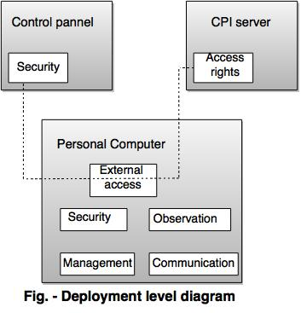
Software Engineering & Testing
Unit 02: Designing of Software
Design modelling :

Slide 35
Software Engineering & Testing
Unit 02: Designing of Software
DESIGN PRINCIPLES:
The design process is a sequence of steps that enable the designer to describe all aspects of the software to be built.
the design model that is created for software provides a variety of different views of the computer software.

Slide 36
Software Engineering & Testing
Unit 02: Designing of Software
DESIGN PRINCIPLES:
1) The design process should not suffer from “tunnel vision.”
- A good designer should consider alternative approaches.
2) The design should be traceable to the analysis model.
- Because a single element of the design model often traces to multiple requirements, it is necessary to have a means for tracking how requirements have been satisﬁed by the design model

Slide 37
Software Engineering & Testing
Unit 02: Designing of Software
DESIGN PRINCIPLES:
3) The design should not reinvent the wheel.
- Design time should be invested in representing truly new ideas and integrating those patterns that already exist.
4) The design should “minimize the intellectual distance” between the software and the problem as it exists in the real world.
-That is, the structure of the software design should (whenever possible) mimic the structure of the problem domain.

Slide 38
Software Engineering & Testing
Unit 02: Designing of Software
DESIGN PRINCIPLES:
5) The design should exhibit uniformity and integration.
Rules of style and format should be deﬁned for a design team before design work begins.
6) The design should be structured to accommodate change.
-The design concepts discussed in the next section enable a design to achieve this principle.

Slide 39
Software Engineering & Testing
Unit 02: Designing of Software
DESIGN PRINCIPLES:
7) The design should be structured to degrade gently, even when aberrant data, events, or operating conditions are encountered.
-Well designed software should never “bomb.” It should be designed to accommodate unusual circumstances, and if it must terminate processing, do so in a graceful manner.
8) Design is not coding, coding is not design.
- The only design decisions made at the coding level address the small implementation details that enable the procedural design to be coded.

Slide 40
Software Engineering & Testing
Architectural Design
Software Architecture:
-This Design has been described as a multi-step process in which representations of data and program structure, interface characteristics, and procedural detail are synthesized from information requirements.
-The process of defining a collection of hardware and software components and their interfaces to establish the framework for the development of a computer system

Slide 41
Software Engineering & Testing
Architectural Design
Software Architecture:
There are many architectural styles, each style will describe a system category that consists of
1) A set of components(eg: a database, computational modules) that will perform a function required by the system.
2) The set of connectors will help in coordination, communication, and cooperation between the components.
3) Conditions that how components can be integrated to form the system.
4) Semantic models that help the designer to understand the overall properties of the system.

Slide 42
Software Engineering & Testing
Architectural Design
Software Architecture:
Taxonomy of Architectural styles & Patterns :
1) Data centered architectures:
-A data store (e.g., a ﬁle or database) resides at the center of this architecture and is accessed frequently by other components that update, add, delete, or otherwise modify data within the store.
- client software accesses the data independent of any changes to the data or the actions of other client software.

Slide 43
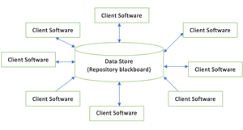
Software Engineering & Testing
Architectural Design
Software Architecture:
Taxonomy of Architectural styles & Patterns : 1) Data centered architectures:

Slide 44
Software Engineering & Testing
Architectural Design
Software Architecture:
Taxonomy of Architectural styles & Patterns :
2) Data-ﬂow architectures :
-This architecture is applied when input data are to be transformed through a series of computational or manipulative components into output data.
- Each component, known as filter, transforms the data and sends this transformed data to other filters for further processing using the connector, known as pipe.

Slide 45
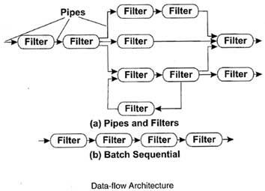
Architectural Design
Software Architecture:
Taxonomy of Architectural styles & Patterns :
2) Data-ﬂow architectures :
-

Slide 46
Architectural Design
Software Architecture:
Taxonomy of Architectural styles & Patterns :
3) Call and return architecture-
-A call and return architecture enables software designers to achieve a program structure, which can be easily modified. This style consists of the following two sub-styles.
a) Main program/subprogram architecture
b) Remote procedure call architecture

Slide 47
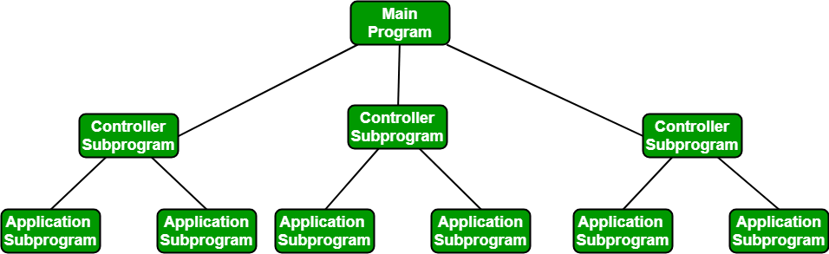
Architectural Design
a) Main program/subprogram architecture:
In this, function is decomposed into a control hierarchy where the main program invokes a number of program components, which in turn may invoke other components.

Slide 48
Architectural Design
b) Remote procedure call architecture:
In this, components of the main or subprogram architecture are distributed over a network across multiple computers.

Slide 49
Architectural Design
4) Object-oriented architectures.
The components of a system encapsulate data and the operations that must be applied to manipulate the data. Communication and coordination between components is accomplished via message passing.
Object protect the system’s integrity.

Slide 50
Architectural Design
5) Layered Architecture:
In layered architecture, several layers (components) are defined with each layer performing a well-defined set of operations.
Each layer will do some operations that becomes closer to machine instruction set progressively.
At the outer layer, components will receive the user interface operations and at the inner layers, components will perform the operating system interfacing(communication and coordination with OS)
-Intermediate layers to utility services and application software functions.

Slide 51
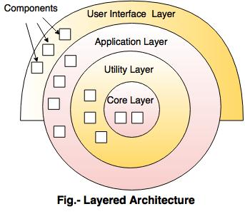
Architectural Design
5) Layered Architecture:

Slide 52
Architectural Design
USER INTERFACE DESIGN-
Interface design focuses on three areas of concern:
the design of interfaces between software components.
the design of interfaces between the software and other nonhuman producers and consumers of information (i.e., other external entities), and
the design of the interface between a human (i.e., the user) and the computer

Slide 53
Architectural Design
USER INTERFACE DESIGN-
THE GOLDEN RULES OF UI DESIGN
1. Place the user in control.
2. Reduce the user’s memory load.
3. Make the interface consistent

Slide 54
Architectural Design
USER INTERFACE DESIGN-
THE GOLDEN RULES OF UI DESIGN
1. Place the user in control.
A number of design principles that allow the user to maintain control:
1) Define interaction modes in a way that does not force a user into unnecessary or undesired actions
2) Provide for ﬂexible interaction.
3) Allow user interaction to be interruptible and undo ( CTR+Z). Streamline interaction as skill levels advance and allow the interaction to be customized.
4) Hide technical internals from the casual user.
5) Design for direct interaction with objects that appear on the screen

Slide 55
Architectural Design
USER INTERFACE DESIGN-
THE GOLDEN RULES OF UI DESIGN
2. Reduce the User’s Memory Load
-The more a user has to remember, the more error-prone will be the interaction with the system.
-Principles that enable an interface to reduce the user’s memory load:
1) Reduce demand on short-term memory.
2) Establish meaningful defaults.
3) Deﬁne shortcuts that are intuitive.
4) The visual layout of the interface should be based on a real world metaphor.
5) Disclose information in a progressive fashion.

Slide 56
Architectural Design
USER INTERFACE DESIGN-
THE GOLDEN RULES OF UI DESIGN
3. Make the Interface Consistent
A set of design principles that help make the interface consistent:
1)Allow the user to put the current task into a meaningful context.
2) Maintain consistency across a family of applications.
3) If past interactive models have created user expectations, do not make changes unless there is a compelling reason to do so.

Slide 57
Architectural Design
USER INTERFACE DESIGN-
.1 Interface Design :
a) A design model of the entire system incorporates data, architectural, interface, and procedural representations of the software.
b) To build an effective user interface,
"all design should begin with an understanding of the intended users, including proﬁle of their age, gender, physical abilities, education, cultural or ethnic background, motivation, goals and personality"

Slide 58
Architectural Design
USER INTERFACE DESIGN-
.1 Interface Design Models :
While designing UI models UI USERS can be categorized as
1)Novices-
No syntactic knowledge of the system and little semantic knowledge of the application or computer usage in general.
2) Knowledgeable, intermittent users-
Reasonable semantic knowledge of the application but relatively low recall of syntactic information necessary to use the interface.
3) Knowledgeable, frequent users-
Good semantic and syntactic knowledge that often leads to the "power-user syndrome"; that is, individuals who look for shortcuts and abbreviated modes of interaction.

Slide 59
Architectural Design
USER INTERFACE DESIGN-
2) The user interface design process :
This process encompasses four distinct framework activities :
User, task, and environment analysis and modelling
Interface design
Interface construction
Interface validation

Slide 60
Architectural Design
USER INTERFACE DESIGN-
2) The user interface design process :
This process encompasses four distinct framework activities :
User, task, and environment analysis and modelling
Interface design
Interface construction
Interface validation

Slide 61
Architectural Design
Unified Modeling Language
-The (UML) is a general-purpose visual modeling lan- guage that is used to specify, visualize, construct, and document the artifacts of a software system.
- It is used to understand, design, browse, configure, maintain, and control information about such systems.
- UML includes semantic concepts, notation, and guidelines.
- UML is not a programming language, it is rather a visual language.

Slide 62
Architectural Design
Unified Modeling Language
- Object Oriented Concepts Used in UML –
Class – A class defines the blue print i.e. structure and functions of an object.
Objects – Objects help us to decompose large systems and help us to modularize our system.
Inheritance – Inheritance is a mechanism by which child classes inherit the properties of their parent classes.
Abstraction – Mechanism by which implementation details are hidden from user.
Encapsulation – Binding data together and protecting it from the outer world is referred to as encapsulation.
Polymorphism – Mechanism by which functions or entities are able to exist in different forms.

Slide 63
Architectural Design
Unified Modeling Language
- What Is a Model?
-A model is a representation in a certain medium of something in the same or another medium.
The model captures the important aspects of the thing being modeled from a certain point of view and simplifies or omits the rest.
The model has both semantics and notation and can take various forms that include both pictures and text.

Slide 64
Architectural Design
Unified Modeling Language
- What Are Models For?
-To capture and precisely state requirements and domain knowledge so that all stakeholders may understand and agree on them. .
To think about the design of a system.
To capture design decisions in a mutable form separate from the requirements.
To generate usable work products.
To organize, find, filter, retrieve, examine, and edit information about large systems.
To explore multiple solutions economically.

Slide 65
Architectural Design
Unified Modeling Language
- What Is in a Model?
Semantics and presentation. Models have two major aspects: semantic information (semantics) and visual presentation (notation).

Slide 66
Architectural Design
Unified Modeling Language
Now we will explore three object modelling Methodologies namely
1)Rumbaugh,
2) Booch
3) and Jacobson.

Slide 67
Architectural Design
Unified Modeling Language
1)Rumbaugh :
-The Rumbaugh methodology also known as OMT (Object Modeling Technique)
-OMT is an approach used to develop manageable object-oriented systems and host object oriented programming.
-The purpose is to allow for class attributes, methods, inheritance, and association to be easily expressed.

Slide 68
Architectural Design
Unified Modeling Language
1)Rumbaugh :
OMT consists of four stages:
1) Analysis
2) Systems Design
3) Object Design
4) Implementation
Additionally, OMT is always broken down into three separate parts. These parts are the:
1) An object model- object model & data dictionary.
2)A dynamic model - state diagrams & event flow
diagrams.
3)A functional model - data flow & constraints.

Slide 69
Architectural Design
Unified Modeling Language
An object model- object model & data dictionary.
– Classes : a set of individual objects .
– Association lines: relationship among classes .
-Classes interconnected by association lines

Slide 70
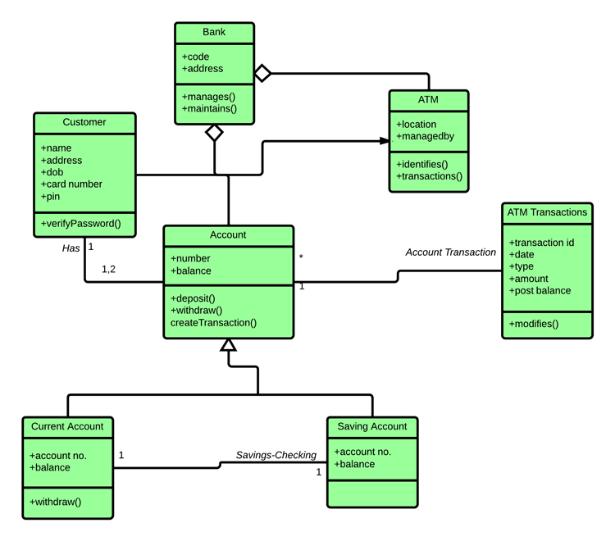
Architectural Design
Unified Modeling Language
An object model- object model & data dictionary.

Slide 71
Architectural Design
Unified Modeling Language
2) A dynamic model :
- state diagrams & event flow diagrams.
- OMT state transition diagram-network of states and events

Slide 72
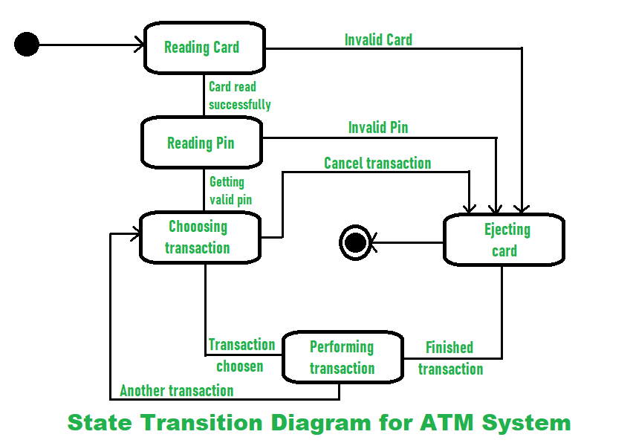
Architectural Design
Unified Modeling Language
2) A dynamic model :
- state diagrams & event flow diagrams.
- OMT state transition diagram-network of states and events

Slide 73
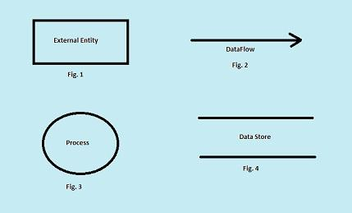
Architectural Design
Unified Modeling Language
3)A functional model - data flow & constraints.
- Shows flow of data between different processes in a business.
– Simple and intuitive method for describing business processes without focusing on the details of computer systems.

Slide 74
Architectural Design
Unified Modeling Language
3)A functional model - data flow & constraints.
- Shows flow of data between different processes in a business.
– Simple and intuitive method for describing business processes without focusing on the details of computer systems.

Slide 75
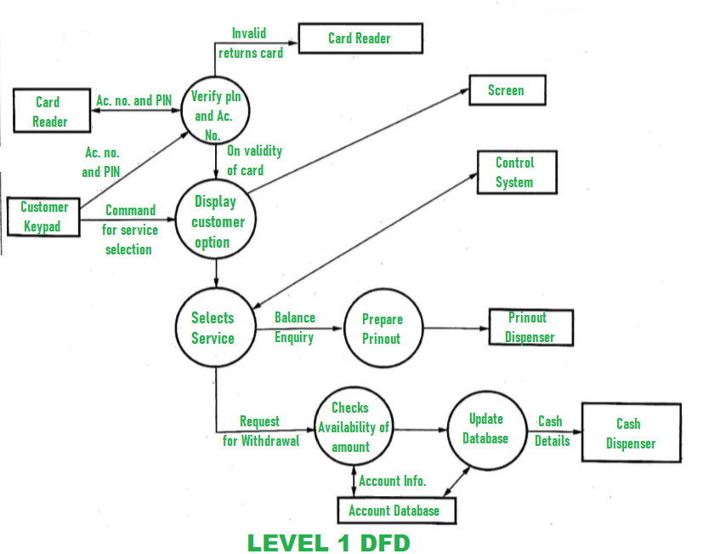
Architectural Design
Unified Modeling Language
3)A functional model - data flow & constraints.
- Shows flow of data between different processes in a business.
– Simple and intuitive method for describing business processes without focusing on the details of computer systems.

Slide 76
Architectural Design
Unified Modeling Language
2) Booch Methodology
Diagrams of Booch method
• Class diagrams describe roles and responsibilities of objects
• Object diagrams describe the desired behaviour of the system in terms of scenarios
• State transition diagrams state of a class based on a stimulus
• Module diagrams to map out where each class & object should be declared
• Process diagrams to determine to which processor to allocate a process
• Interaction diagrams describes behaviour of the system in terms of scenarios

Slide 77
Architectural Design
Unified Modeling Language
2) Booch Methodology
a) Macro Development Process
b)Micro Development Process

Slide 78
Architectural Design
Unified Modeling Language
2) Booch Methodology
a) Macro Development Process
• Steps for macro development process
Conceptualization
Analysis & Development of the model
Design or create the system architecture
Evolution or implementation
Maintenance

Slide 79
Architectural Design
Unified Modeling Language
2) Booch Methodology
b) Micro Development Process
• Each macro process has its own micro development process
Steps:
- Identify classes & objects
- Identify class & objects semantics
- Identify class & object relationship
- Identify class & objects interface and implementation

Slide 80
Architectural Design
Unified Modeling Language
3) The Jacobson methodology :
also known as Object-Oriented Software Engineering (OOSE) or even Objectory,
- OOSE is a method used to plan, design, and implement object-oriented software.
- OOSE consist of five parts: a set of requirements, an analysis, a design, an implementation, and a testing model.
-the methodology or OOSE utilizes use cases in its design.

Slide 81
Architectural Design
Unified Modeling Language
3) The Jacobson methodology :
Use Cases
-Use cases help us understand the how we want to design our system.
-Use cases are scenarios for helping us understanding the requirements of our system.
We can see a use case as an interaction between a user and the system.
-

Slide 82
Architectural Design
Unified Modeling Language
3) The Jacobson methodology :
Use Cases
A use case must contain these several elements:
-The how and when the use case begins and ends.
-Shows interactions between the various actors - when the interaction occurs and what material is exchanged
-The how and when of data storage and data usage
Exceptions.
The how the constraints of the problem domain are handled.

Slide 83
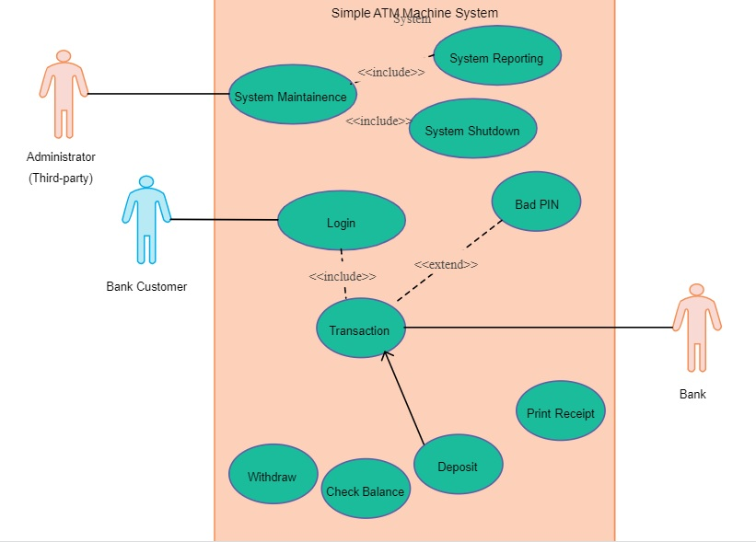
Architectural Design
Unified Modeling Language
3) The Jacobson methodology :
Use Cases
A use case must contain these several elements:
-The how and when the use case begins and ends.
-Shows interactions between the various actors - when the interaction occurs and what material is exchanged
-The how and when of data storage and data usage
Exceptions.
The how the constraints of the problem domain are handled.

Slide 84
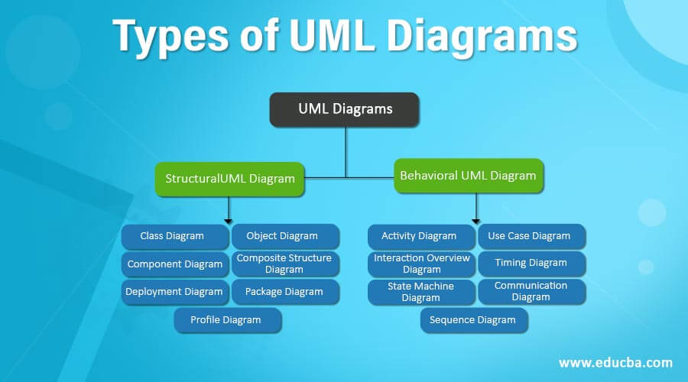
Architectural Design
Unified Modeling Language

Slide 85
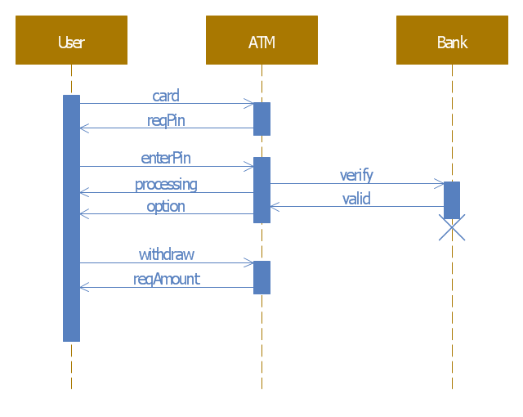
Architectural Design
Unified Modeling Language

Slide 86
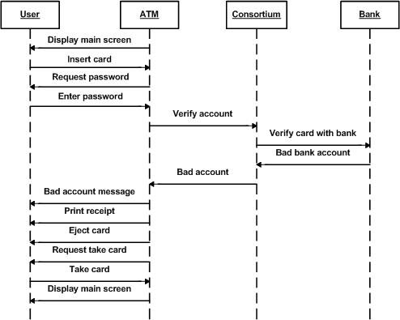
Architectural Design
Unified Modeling Language

Slide 87
Use Case Diagram :
-These diagrams identify the interactions between the system and its actors.
-The use cases and actors in use-case diagrams describe what the system does and how the actors use it, but not how the system operates internally.
It depicts the high-level functionality of a system and also tells how the user handles a system.
-It depicts the external view of the system.

Slide 88
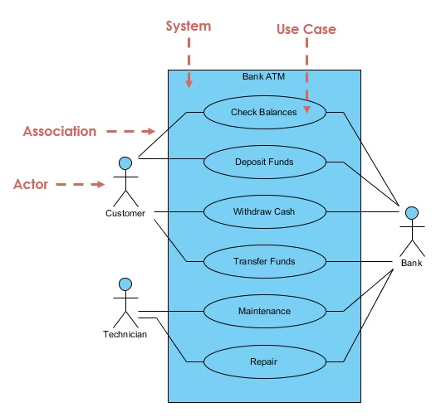
Use Case Diagram :

Slide 89
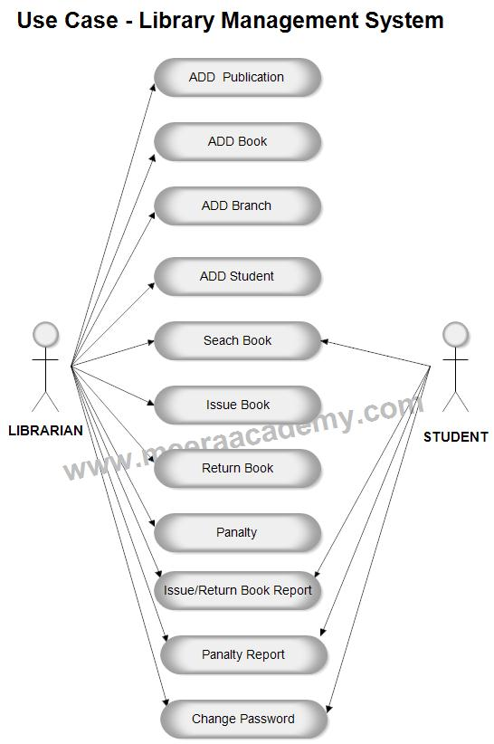
Use Case Diagram :

Slide 90
Interaction Diagram:
Interaction diagrams is use to visualize the interactive behaviour of the system.
Interaction Diagram are used to establish communication between objects.
This interactive behavior is represented in UML by two diagrams known as Sequence diagram and Collaboration diagram. The basic purpose of both the diagrams are similar.
Interaction diagrams mostly focus on message passing .
Interaction diagrams capture the dynamic behavior of the system.

Slide 91
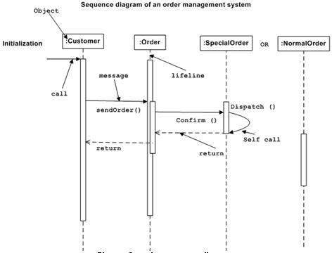
Interaction Diagram:

Slide 92
Interaction Diagram for Log In System:

Slide 93




State Transition diagram:
-This is used to represent different transition (changing) states of a System.
-It is generally used to graphically represent all possible transition states a system can have and model such systems.
-The System consists of various states that are being represented using various symbols in the state transition diagram. You can see the symbols and their description given below :
Initial State –
Final State –
Simple State –
Composite State –

Slide 94
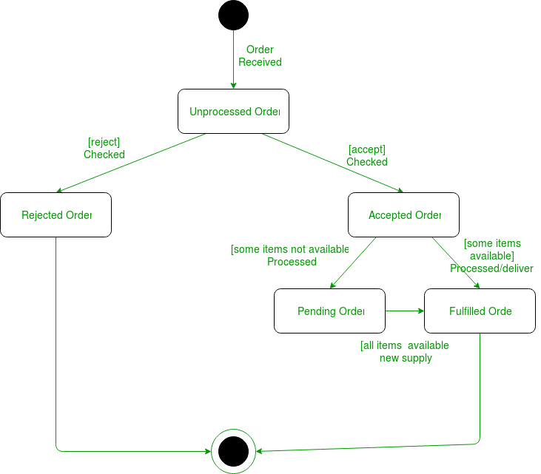
State Transition diagram:
-

Slide 96
Class diagram:
Class diagram is a static diagram. It represents the static view of an application.
Class diagram is not only used for visualizing, describing, and documenting different aspects of a system
Class diagram shows a collection of classes, interfaces, associations, collaborations, and constraints.
It is also known as a structural diagram.
Class diagrams are the only diagrams which can be directly mapped with object-oriented languages.

Slide 97
Class diagram:
- The purpose of the class diagram can be summarized as −
Analysis and design of the static view of an
application.
2) Describe responsibilities of a system.
3) Base for component and deployment diagrams.
4) Forward and reverse engineering.

Slide 98
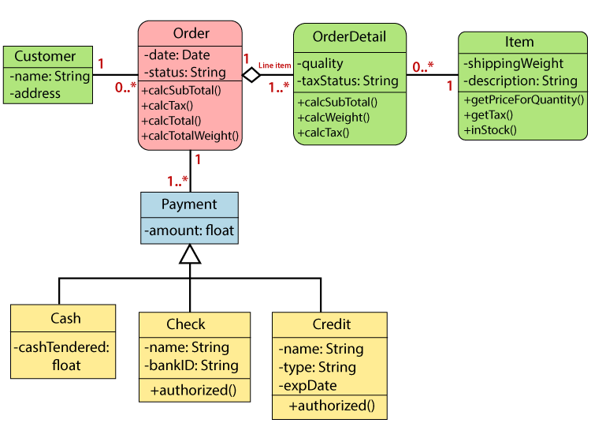
Class diagram:
- A class diagram describing the sales order system is given below.

Slide 99
Class diagram:
A class diagram uses
1) To describe the static view of a system.
2) To show the collaboration among every instance in the static view.
3) To describe the functionalities performed by the system.
4) To construct the software application using object-oriented languages.

Slide 100
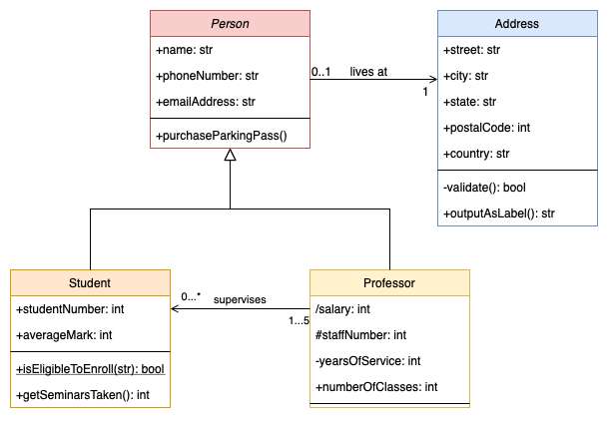
Class diagram of student and Teacher:

Slide 101
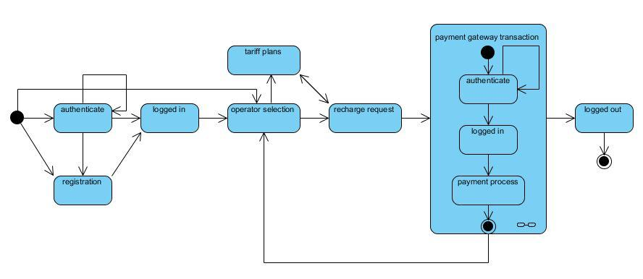
State diagram Of recharge

Slide 102
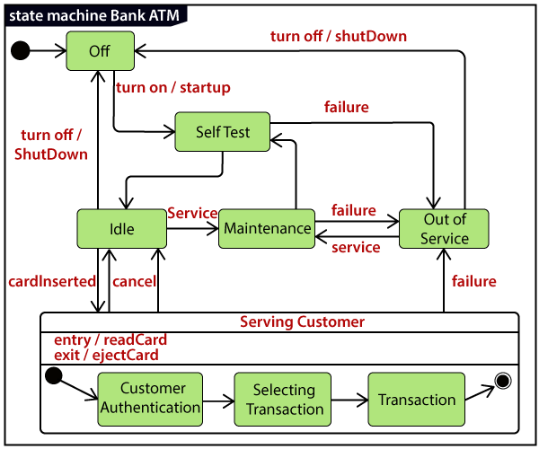
State diagram Of ATM

Slide 103
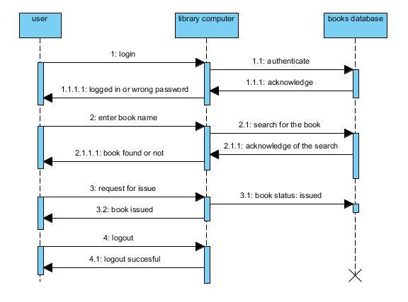
Inter action dig of Library

